Slide 1

Fingerprinting Vehicles with CAN Bus Data Samples
2d Lt David Crow, USAF
Air Force Institute of Technology
Graduate School of Engineering and Management
Department of Electrical and Computer Engineering
SU19 csce 823 final project
August 2019
1/22
Notes:
Hi, I’m 2d Lt David Crow. My research is about Fingerprinting Vehicles with CAN Bus Data Samples.

Slide 2
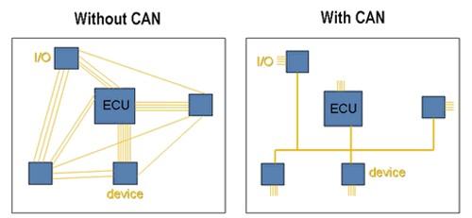
Problem Domain
CAN is good
[1]
2/22
Notes:
Here’s a picture of a controller area network. These are installed in most vehicles.

Slide 3
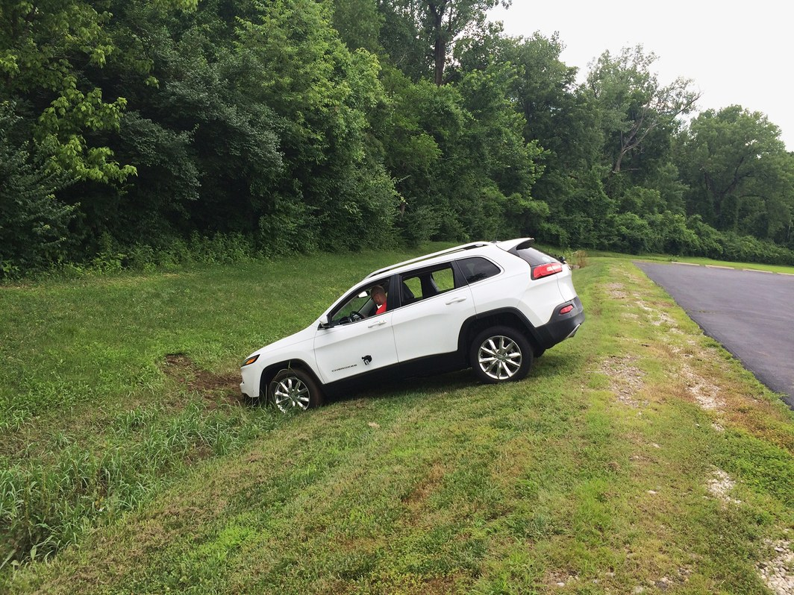
Problem Domain
CAN is good
CAN is bad
Hackers Remotely Kill Jeep on the Highway – With Me In It [2]
3/22
Notes:
Although the CAN clearly reduces system complexity, the network's connectedness means it's a prime target for malicious intruders. If an attacker gains access to the CAN bus through any endpoint, they can access the rest of the devices on the network, which include the dashboard, the steering wheel, the brakes, the transmission, the engine, and so on.

Slide 4
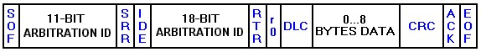
Problem Domain
?
?
?
CAN is good
CAN is bad
CAN is secure
[3]
4/22
Notes:
To address this, modern vehicle manufacturers employ a policy of security through obscurity when designing the CAN bus and its components. Effectively, this means they make it
difficult to interpret the meaning of CAN data without significant reverse engineering efforts.

Slide 5
Problem Domain
?
?
?
CAN is good
CAN is bad
CAN is secure?
CAN is insecure
[3]
MACHINE LEARNING
2013 Ford Focus!
5/22
Notes:
However, this security policy is insufficient for consumer protection because obfuscating a vehicle's CAN data does not adequately hide the vehicle's signature. Why is this? Well,
Today's toolsets can successfully determine whether a specific vehicle generated a specific segment of CAN data, even if said data is unprocessed or limited in scope. This research uses deep learning to do so.

Slide 6
Objective
Does a given vehicle leave identifiable fingerprints on its data?
If so, can we identify these fingerprints?
Probably. Let’s use a CNN.
6/22
Notes:
Specifically, we devise a system capable of identifying which distinct vehicle generated a given segment of CAN bus data. This is a multiclass classification problem which asks the following question: does a given vehicle leave identifiable fingerprints on its data?
We hypothesize that a convolutional neural network can effectively classify vehicles, especially when compared to naive deep learning approaches.

Slide 7
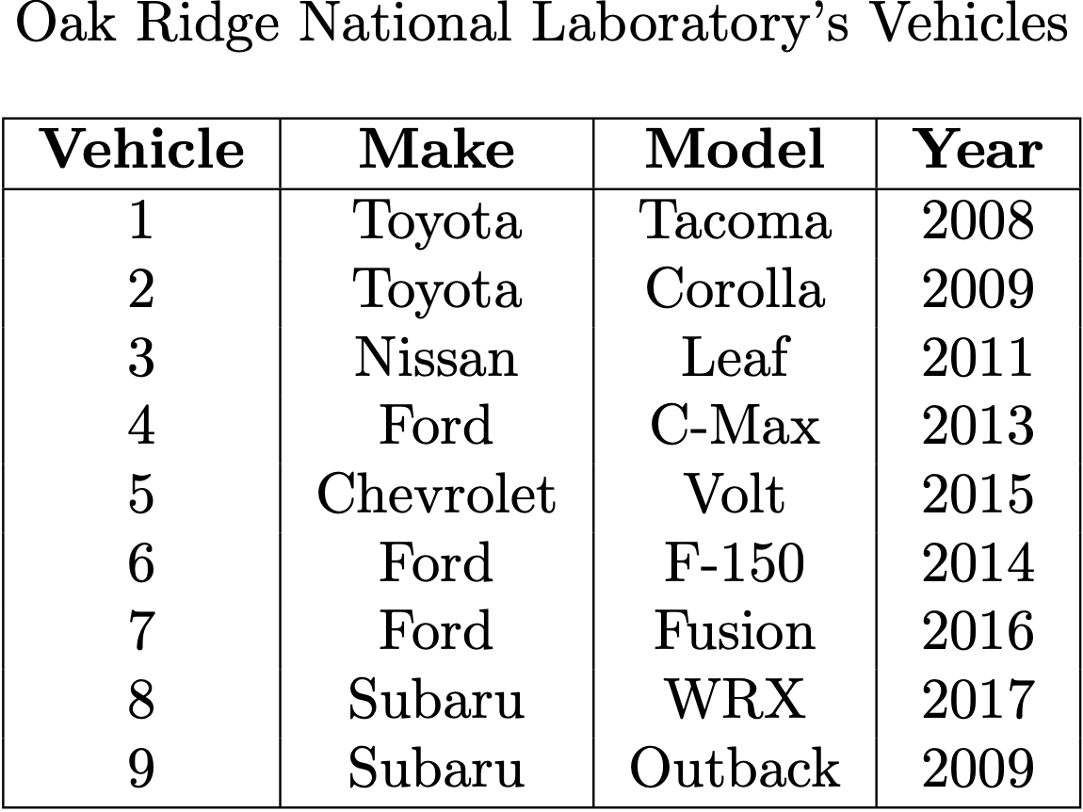
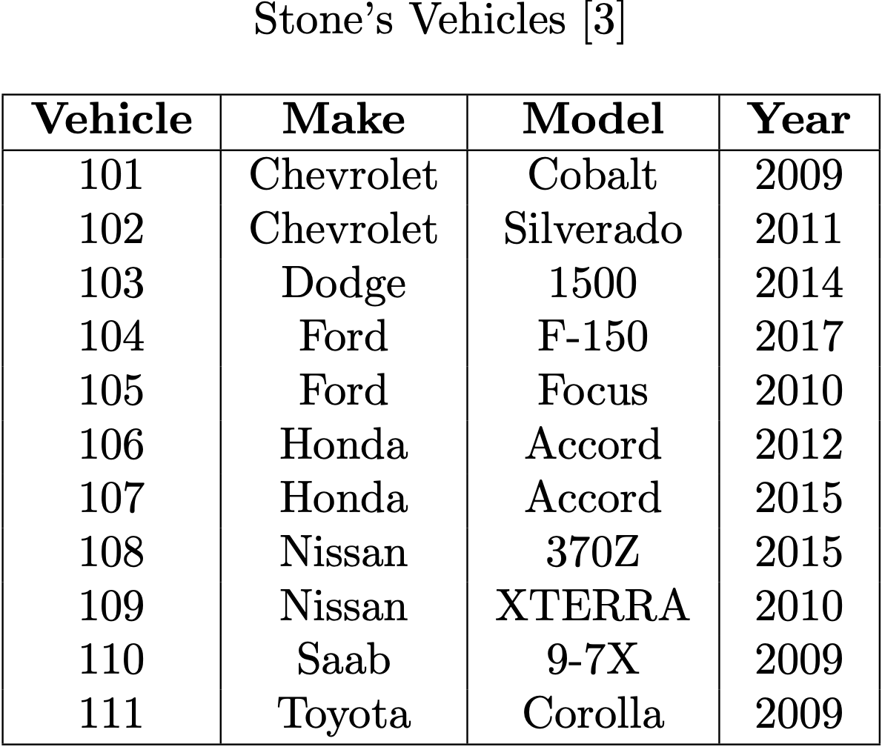
Data
7/22
Notes:
This research employs two datasets, one from Oak Ridge National Laboratory and one from a previous student's research.
The Oak Ridge corpus is comprised of nearly two and a half gigabytes of data captured on the CAN buses of nine different vehicles;
Stone’s corpus contains over 230 megabytes of data from 11 different vehicles.

Slide 8
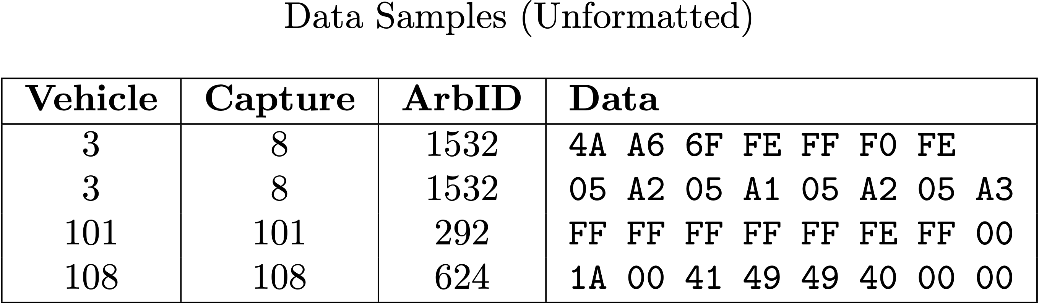
Data
8/22
Notes:
The raw CAN messages in each capture contain a bunch of information. Here's the important stuff. (pause) Each arb ID might detail a vehicle's speed, RPM, tire pressure, brake pedal position … but we don't actually know what it describes.

Slide 9
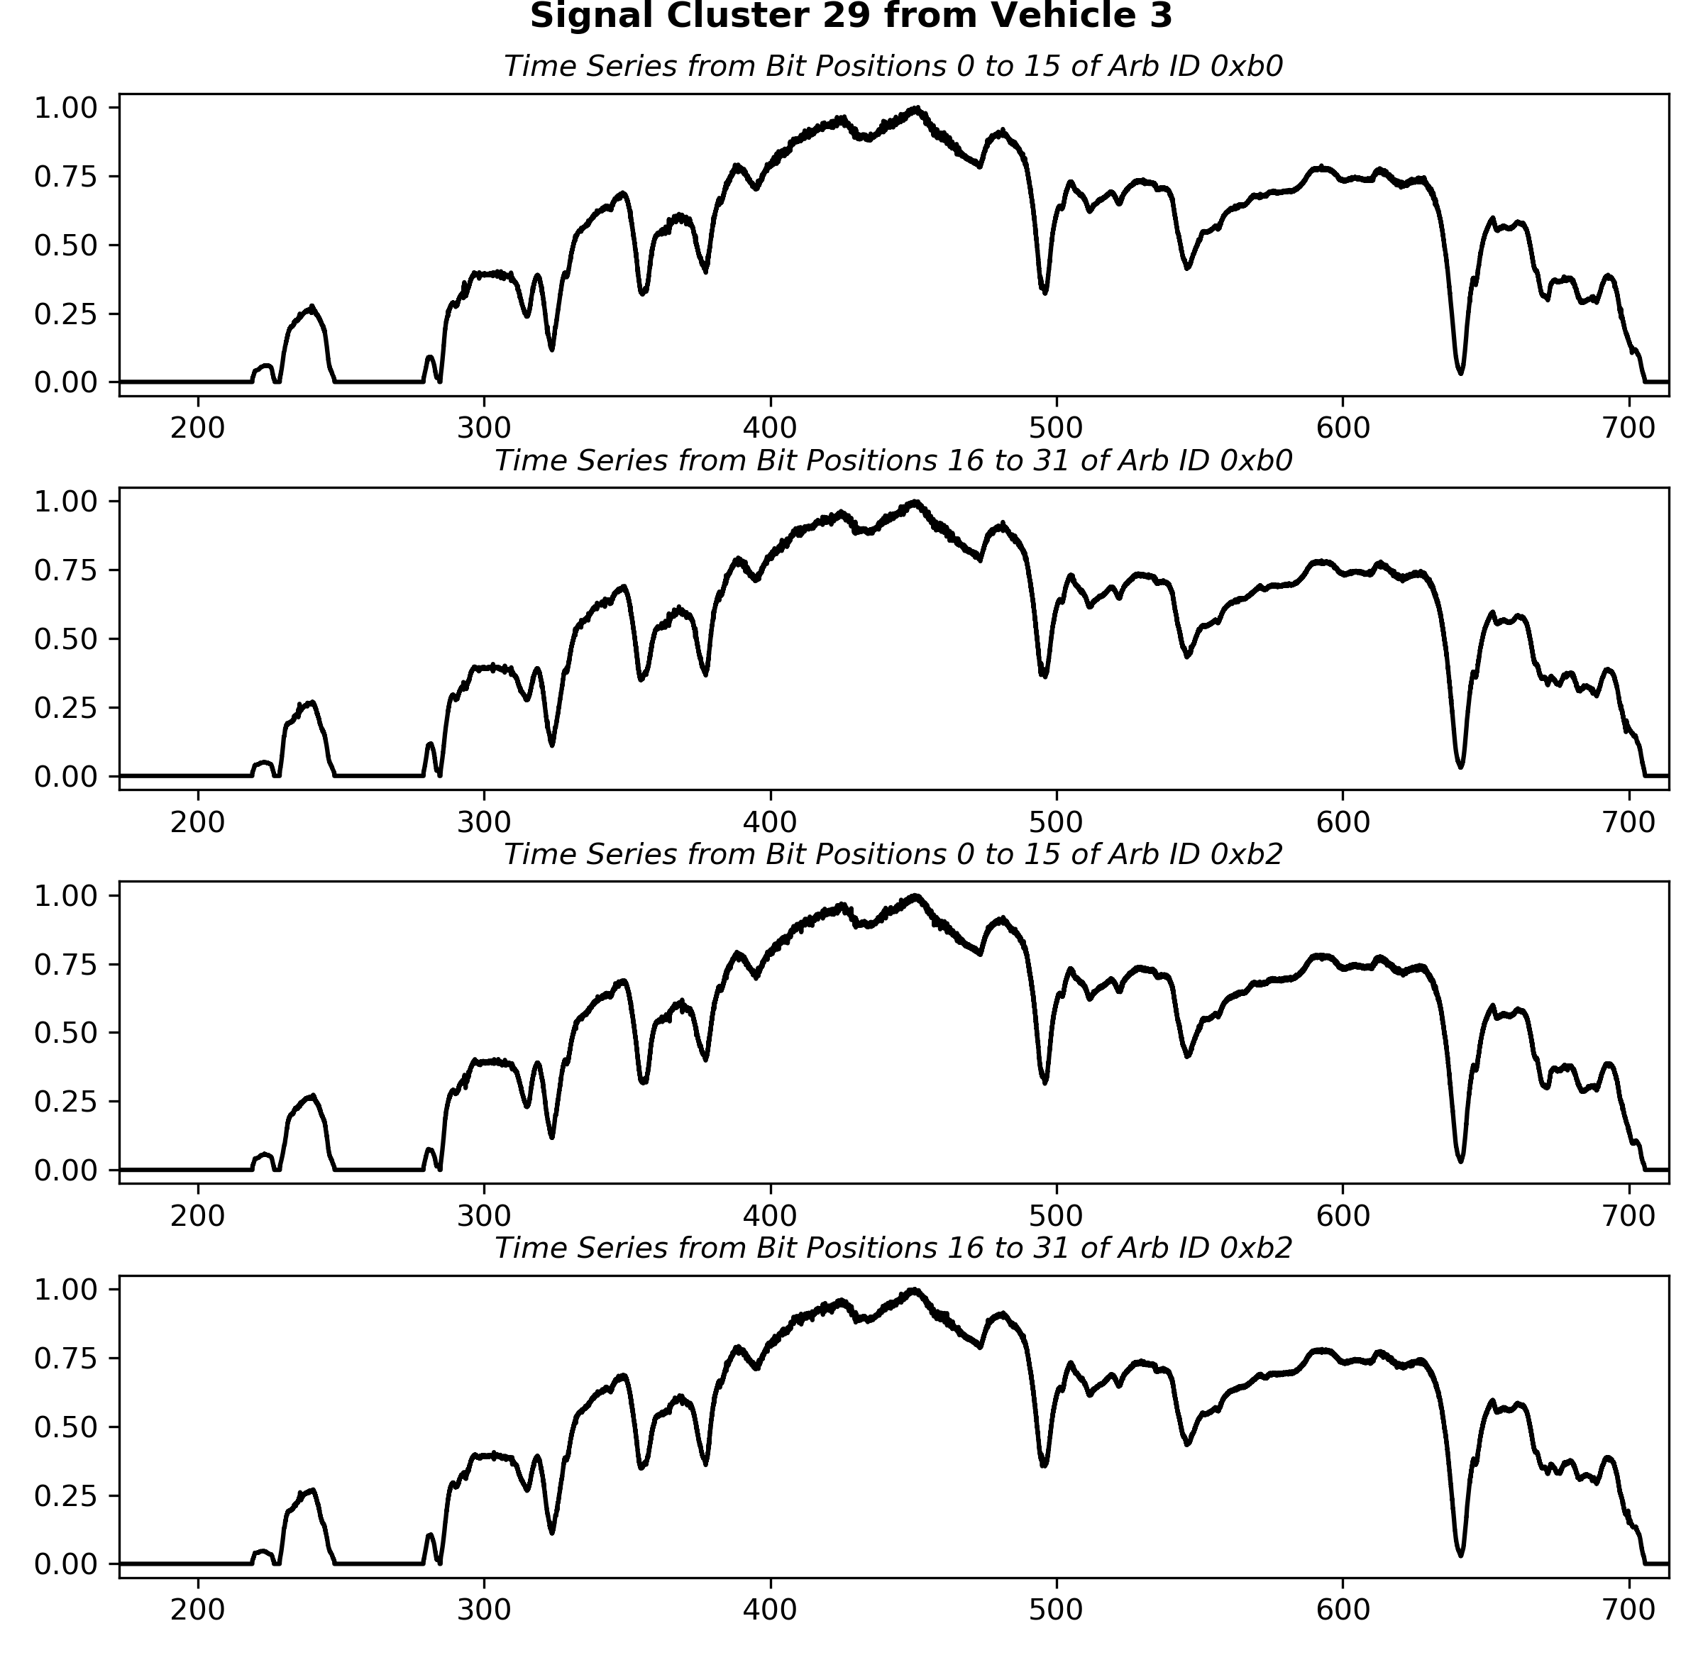
Data
9/22
Notes:
For example, one reverse engineering pipeline might pull these signals from one arb ID. Maybe these are wheel speeds. I don't know. It's impossible to be sure without possessing insider knowledge. We aren’t even sure if these exact signals actually exist in this arb ID.

Slide 10
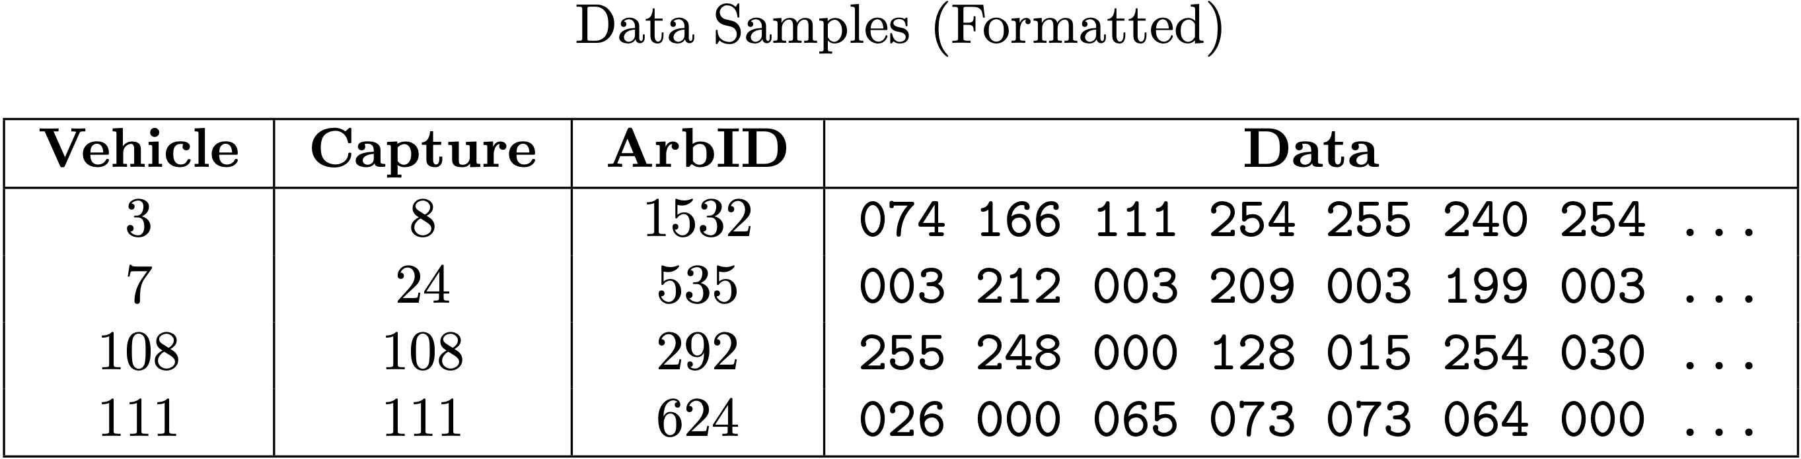
Data
For every arb ID in every vehicle:
Concatenate all data chunks into one string
Split string into list of hex bytes
Convert list of hex bytes to list of int bytes
Split list of int bytes into list of 1,024-byte samples
Label each sample with generating vehicle (fully supervised)
10/22
Notes:
Luckily for us, deep learning doesn't particularly care about the meaning of each arb ID. Thus, for every arb ID in every capture, the formatting process entails the following ...
... First, concatenate all hexadecimal data chunks into one long string. Then, split this string into a list of hex bytes and convert each hex byte to a three-digit integer byte. Every sample in the formatted dataset consists of 1,024 of these integer bytes, and, because each sample is labeled with its generating vehicle, the deep learning task is fully supervised ...
... Formatting the datasets in this way gives nearly three hundred thousand samples.

Slide 11
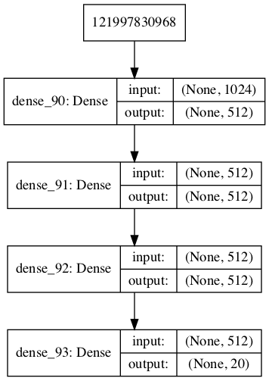
Methodology (Dense Net)
Identifying the best model
27 different architectures
Unbalanced dataset
60/20/20 split
Testing the best model
1,060,372 parameters
80/20 split
Unbalanced and balanced datasets
11/22
Notes:
We then train a simple model on 80% of the data. This simple model is the best version identified in a search over 27 different architectures. Each of the hidden layers uses a ReLU activation function, and the output layer uses softmax. The learning rate is 0.001, and the model has about one million parameters ...
... This model’s performance is actually passable, but we can do a bit better.

Slide 12
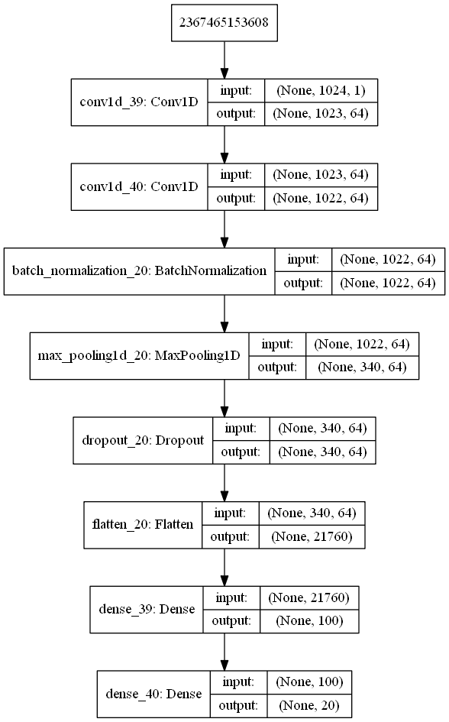
Methodology (convnet)
Identifying the best model
18 different architectures
Unbalanced dataset
60/20/20 split
Testing the best model
2,186,824 parameters
80/20 split
Unbalanced and balanced datasets
12/22
Notes:
So, we also feed the samples into a convolutional neural network. By again looping over model configurations, we identify the best convnet for this task. This one uses 64 filters in each convolutional layer; the kernel size is two. The pooling layer pools over three elements at each step, and the dropout layer sets 50% of its inputs to zero. The activations are again softmax for the output layer and ReLU for the remaining layers. This model has about two million parameters.

Slide 13
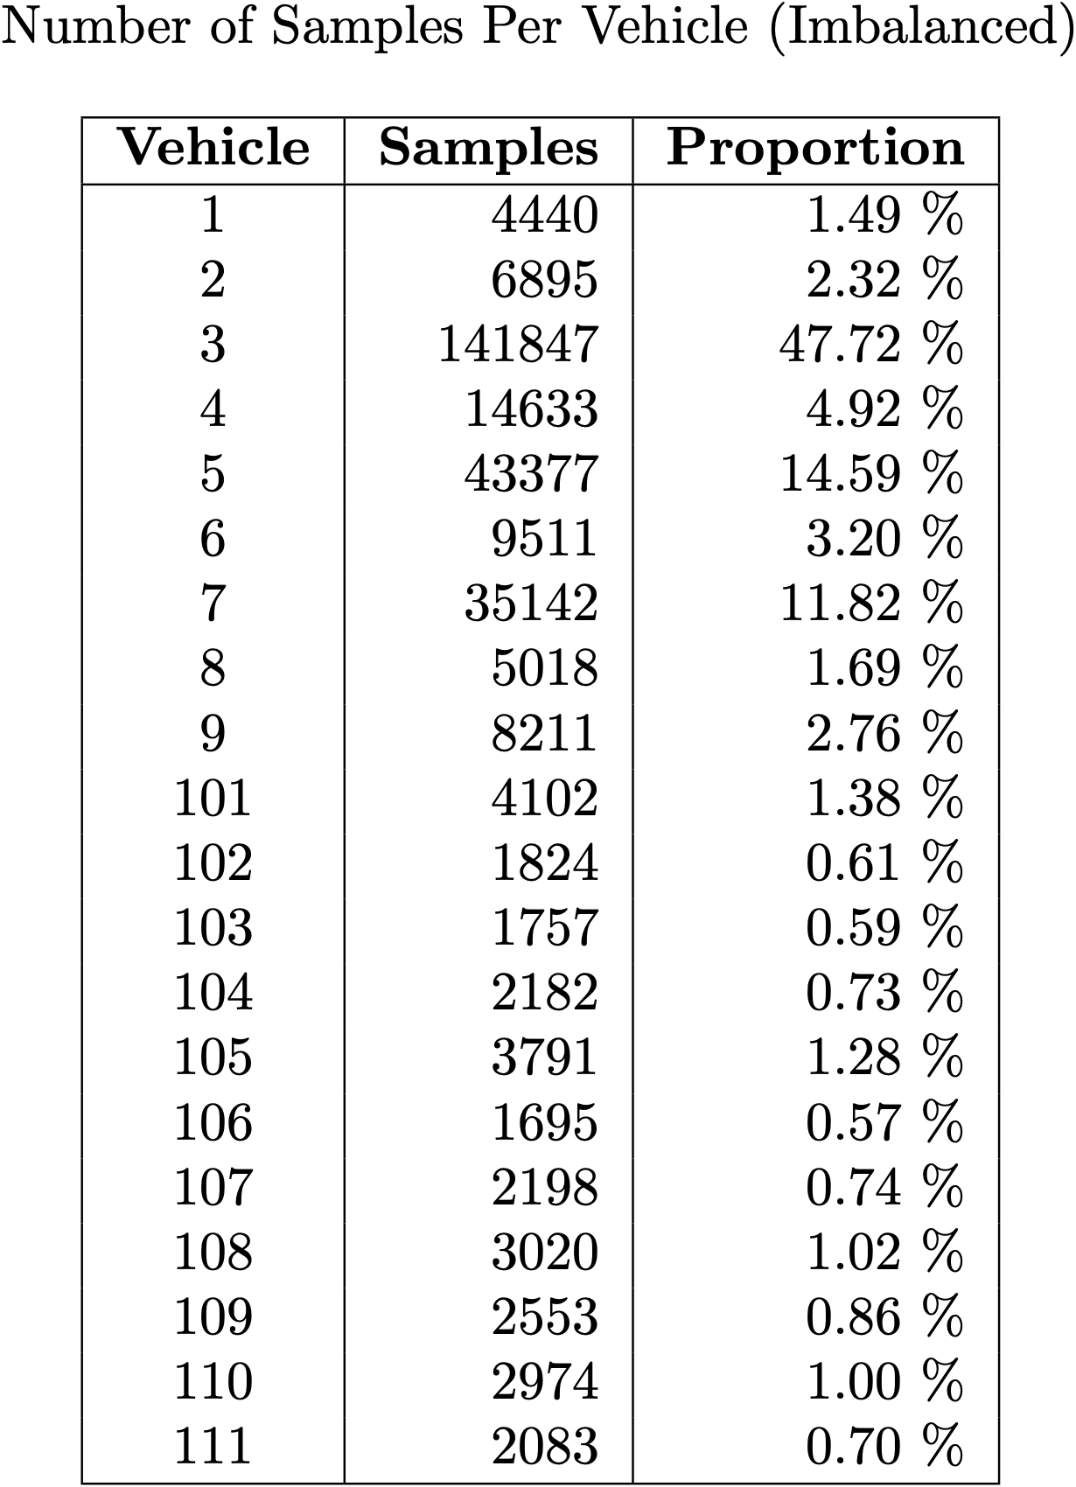
Analysis
13/22
Notes:
The full dataset is severely imbalanced -- Vehicles 3, 5, and 7 are significantly overrepresented, and the remaining vehicles are underrepresented.

Slide 14
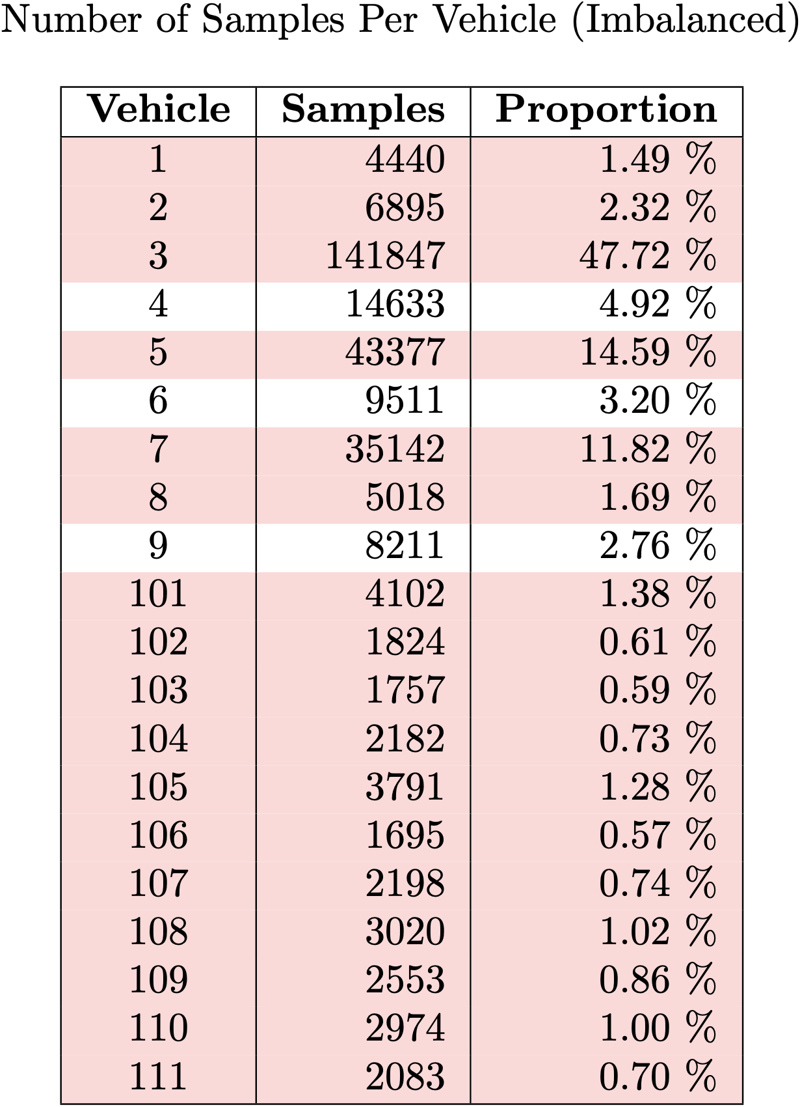
Analysis
14/22
Notes:
The red rows indicate those classes which are significantly over- or underrepresented. To address this imbalance, we train on the full dataset and compute balanced accuracy, which accounts for the imbalance.

Slide 15
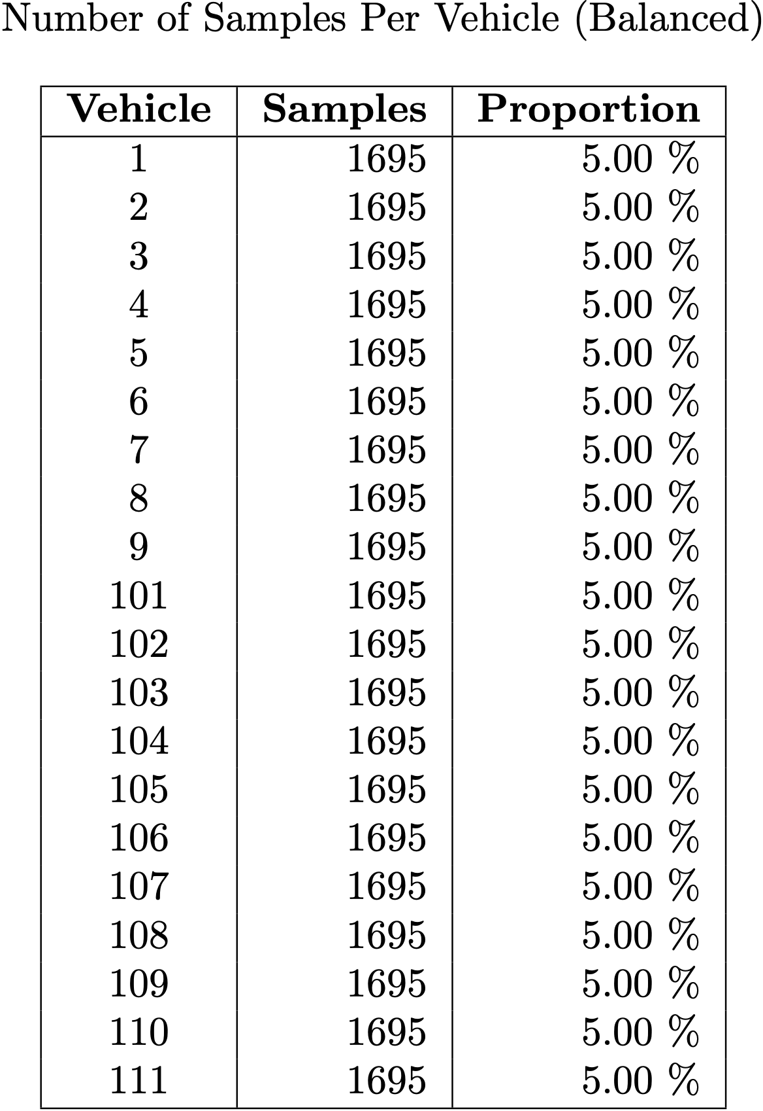
Analysis
15/22
Notes:
We do the same with a balanced dataset, which we generate by randomly down-sampling each of the classes.

Slide 16
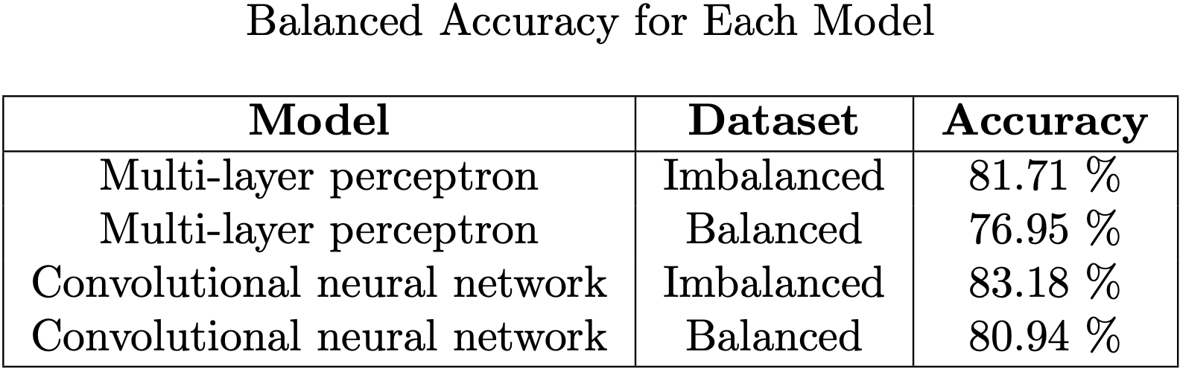
Results
16/22
Notes:
Results indicate that the simple model can adequately classify vehicles, but it's clear that the convnet is a bit better for both
the imbalanced dataset and
the balanced dataset.

Slide 17
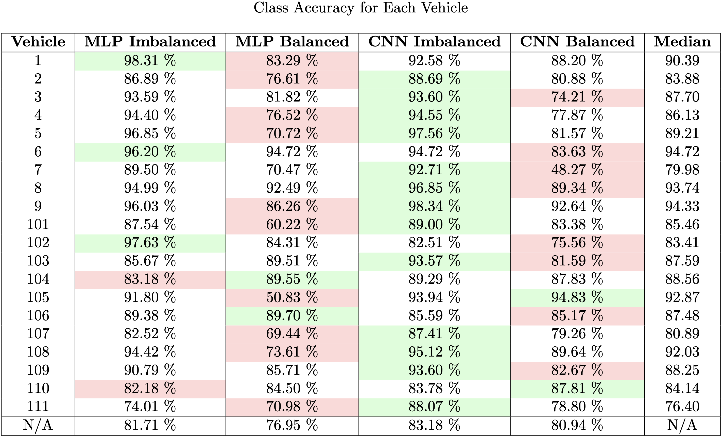
Results
Best model for Vehicle X
Worst model for Vehicle X
17/22
Notes:
Here’s a much larger table of results.
The bottom row of this table shows the same statistics as the previous slide: the balanced accuracy for each model and dataset.
The rows of this table show the class accuracy for each model.
The green cells show the highest accuracy value for a given class, and
the red cells show the lowest.
The rightmost column shows the median accuracy for the four model/dataset combinations. (pause) There’s a lot of information here, but it’s clear at a glance that
the convnet on the imbalanced dataset is better than the other model/dataset combos for most classes.
Additionally, both models demonstrate poor performance across a range of classes when trained on the balanced dataset (as opposed to the imbalanced dataset).

Slide 18
Impact & Limitations
MLP is good
CNN is better
Better models probably exist
Vehicles leave identifiable fingerprints on CAN data
Risks consumer safety
Consistency in data collection is a little questionable
18/22
Notes:
So, what do these results indicate?
Well, the simple dense network is sufficient for classifying CAN data, but
One who needs improved performance can use a convnet instead.
It’s likely that, with further tuning, one could devise an even better classifier.
Clearly, deep learning allows us to sufficiently predict which vehicle generated a given CAN data sample.
This risks consumer safety because a malicious actor who gains access to an unknown vehicle can identify the vehicle using one of these techniques and then better format his attack.
Still, it’s difficult to fully state the impact of these results. The consistency of the data in the dataset is not guaranteed, and further analysis into what the models actually key in on is still required.

Slide 19
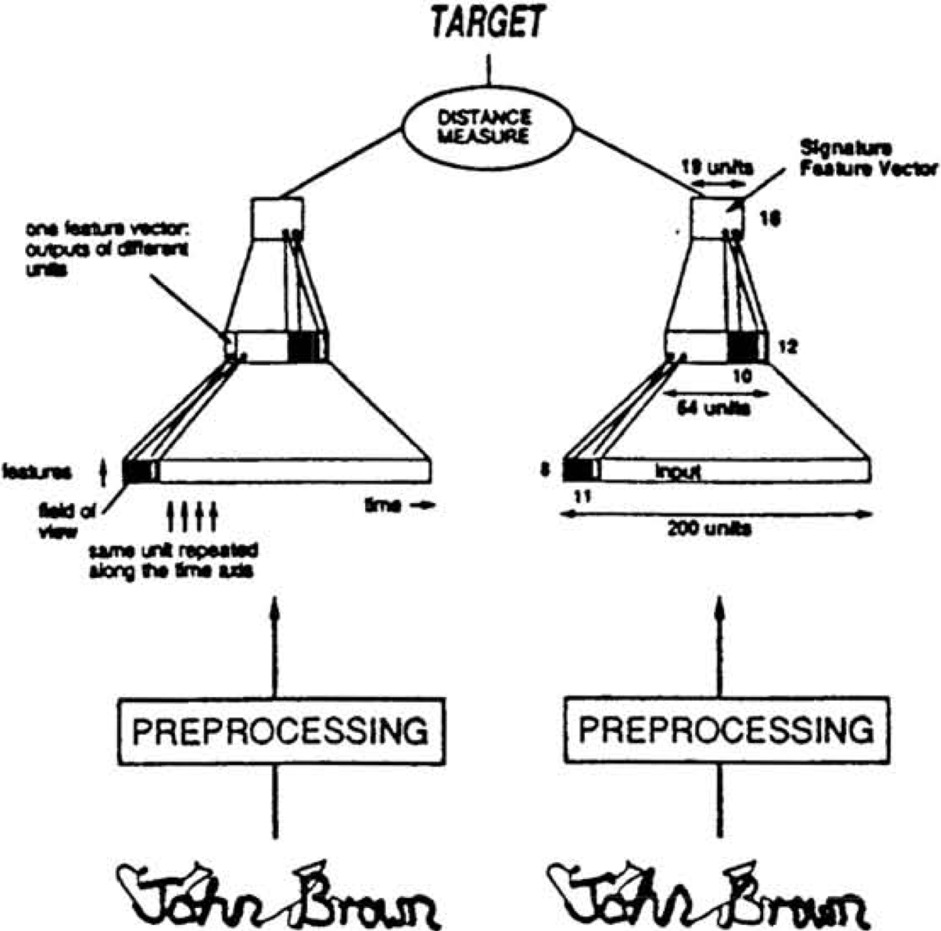
Future Work
19/22
Notes:
Devising a siamese neural network capable of learning the difference between CAN segments is the logical next step for this research. As a reminder, an SNN can generalize to new classes because it learns why two observations come from the same class or from different classes. A standard CNN, on the other hand, must learn every class.

Slide 20
Future Work
Known vehicle (A): 124 221 000 231 …
Known vehicle (A): 017 089 001 000 …
Known vehicle (A): 000 000 000 001 …
Known vehicle (B): 121 179 000 001 …
Known vehicle (A): 001 001 093 200 …
Unknown vehicle: 100 236 019 001 …
}
Same
}
Different
}
Different
20/22
Notes:
For this reason, an SNN is extensible: one can train a siamese net on a set of vehicles and, because it knows why samples from two vehicles are different, one can introduce new vehicles and still maintain solid classification performance.

Slide 21
References
https://www.ni.com/en-us/innovations/white-papers/06/controller-area-network--can--overview.html
https://www.wired.com/2015/07/hackers-remotely-kill-jeep-highway/
Stone, B., Graham, S., Mullins, B., & Schubert Kabban, C. (2018). Enabling Auditing and Intrusion Detection for Proprietary Controller Area Networks. Air Force Institute of Technology.
21/22
Notes:
Here are some references …

Slide 22
Thanks for watching
22/22
Notes:
… and thanks for watching. Let me know if you have any questions!

